Slide 1


Department of Computer Science and Engineering
Visvesvaraya Technological University, Jnana Sangama, Belagavi
Kalpataru Institute Of Technology, Tiptur
A Project Seminar Presentation On
“SUSTAINABLE CROP OPTIMIZATION WITH AI/ML”
Presented By,
A R ADVITHI 1KI20CS001
PRIYA J 1KI20CS075
BHAVANA B V 1KI21CS400
LISHA K R 1KI21CS404
Under the Guidance of,
Prof. Vidya H A B.E., M.Tech., (Ph.D.)
Assistant Professor,
Dept. of CSE, KIT

Slide 2
CONTENTS
Abstract
Introduction
Objectives
Assumptions and Constraints
Methodology
Advantages and disadvantages
Applications
Conclusion
References

Slide 3
ABSTRACT
The agricultural sector is crucial for a country's economy, but farmers face challenges due to a lack of comprehensive knowledge about soil conditions, leading to uncertainties in crop selection, fertilizer usage, and yield optimization.
The project aims to transform traditional farming methods into efficient and profitable practices, helping farmers who rely on outdated techniques.
The recommendation system will assist farmers in making informed decisions about crop selection based on specific geographic and soil parameters.
Core functionalities include providing accurate crop recommendations, optimizing fertilizer usage, employing image classification for plant disease detection, and integrating real-time market prices and relevant agricultural news to aid decision-making.

Slide 4
INTRODUCTION
Farmers in India face challenges due to limited knowledge about soil conditions, leading to uncertainties in crop selection and yield optimization.
The National Crime Records Bureau (NCRB) reported 10,281 farmer suicides in 2019, highlighting issues such as debt and crop failure.
Leveraging advancements in machine learning and deep learning, we aim to develop a recommendation system tailored to empower Indian farmers.
This system will transform traditional farming methods into efficient practices, bridging the gap between outdated techniques and modern technologies.
By assisting farmers in making informed decisions about crop selection and optimizing resource usage, the system aims to enhance yield production.

Slide 5
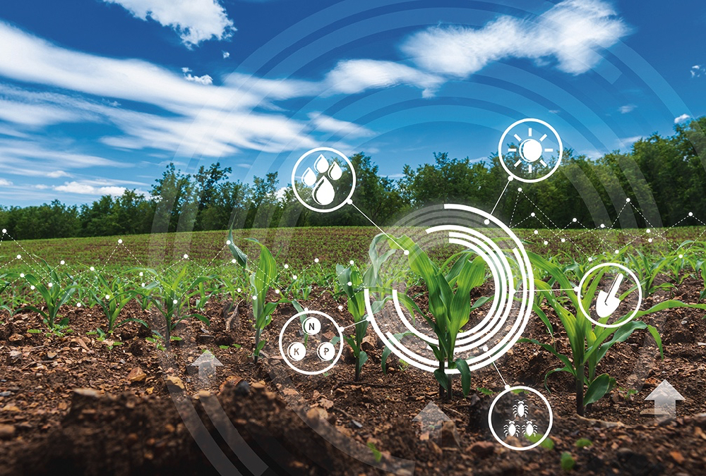
Additionally, the system will address the communication gap between government policies and farmers, serving as an educational tool.
Core functionalities include providing accurate crop recommendations, optimizing fertilizer usage, and employing image classification for disease detection.

Slide 6
OBJECTIVES
To implement precision agriculture (A modern farming technique that uses research data of soil characteristics, soil types, crop yield data collection and suggests the farmers the right crop based on their site specific parameters to reduce the wrong choice on a crop and increase in productivity).
To solve the problem by proposing a recommendation system through an ensemble model with majority voting technique crop for the site specific parameters with high accuracy and efficiency.
To recommend organic fertilizer on the basis of N, P, K values and crop.
To recognize the pest and recommend particular pesticide available in India as per ISO standards (ISO 9001, ISO 14001, ISO 17025).
To design a web application for achieving above objectives.

Slide 7
S.No. | Assumptions and Constraints
1 | Crop Optimization supports 22 crops: apple, banana, black gram, chickpea, coconut, coffee, cotton, grapes, jute, kidney beans, lentil, maize, mango, moth beans, mungbean, muskmelon, orange, papaya, pigeon peas, pomegranate, rice, watermelon. Hence the user will get results which best suit the land but only from these 22 crops.
2 | The system supports 10 pests: aphids, armyworm, beetle, bollworm, earthworm, grasshopper, mites, mosquito, sawfly and stem borer, which is a constraint.
3 | The user can opt for uploading image of the pest or manual selection of the pest: In case of first choice, any other picture of pest uploaded (apart from 10supportedpests) will display the result which is close resemblance with pests supported and in the latter case, the user can only make a selection among 10 pests.
4 | The user must have the picture which clearly shows the pest.(In case the user opts to upload picture)
5 | The user must be connected to the internet so as to access the web application.
6 | The user must enter realistic values for getting the best result.(Though the invalid values are not accepted)
7 | The maximum file size in case of image upload is 2GB and maximum dimensions as per Webp format are:16383 x 16383

Slide 8
S.No. | N | P | K | Temperature | Humidity | pH | Rainfall | Label
1 | 60-99 | 35-60 | 36-45 | 20-26 | 80-84 | 5-7 | 182-298 | Rice
2 | 60-100 | 35-60 | 15-25 | 18-26 | 55-74 | 5-6 | 60-109 | Maize
3 | 22-60 | 56-80 | 75-85 | 17-20 | 14-19 | 5-8 | 70-92 | Chickpea
4 | 0-40 | 55-80 | 15-25 | 15-24 | 18-24 | 5 | 60-149 | Kidney beans
5 | 0-40 | 55-80 | 15-25 | 18-36 | 30-69 | 4-7 | 90-198 | Pigeon peas
6 | 0-40 | 35-59 | 15-25 | 24-31 | 40-64 | 3.5-9.9 | 30-74 | Moth beans
7 | 0-40 | 35-60 | 15-25 | 29 | 80-89 | 6.2-7.1 | 36-59 | Mung bean
8 | 20-60 | 55-80 | 15-25 | 29 | 60-69 | 6.5-7.7 | 60-74 | Black gram
9 | 0-40 | 55-80 | 15-25 | 29 | 60-69 | 5.9-7.8 | 35-54 | Lentil
10 | 0-40 | 5-30 | 35-45 | 29 | 85-94 | 5.5-7.1 | 102-112 | Pomegranate
11 | 80-120 | 70-95 | 45-55 | 29 | 75-84 | 5.5-6.4 | 90-119 | Banana
12 | 0-40 | 15-40 | 25-35 | 29 | 45-54 | 4.5-6.9 | 89-100 | Mango
13 | 0-40 | 120-145 | 195-205 | 29 | 80-83 | 5.5-6.4 | 65-74 | Grapes
14 | 80-120 | 5-30 | 45-55 | 29 | 80-89 | 6-6.9 | 40-59 | Watermelon
15 | 80-120 | 5-30 | 45-55 | 29 | 90-94 | 6-6.7 | 20-29 | Muskmelon
16 | 0-40 | 120-145 | 195-205 | 29 | 90-94 | 5.5-6.4 | 100-124 | Apple

Slide 9
S.No | N | P | K | Temperature | Humidity | pH | Rainfall | Label
17 | 0-40 | 5-30 | 5-15 | 29 | 90-94 | 6-7.9 | 100-119 | Orange
18 | 31-70 | 46-70 | 45-55 | 29 | 90-94 | 6.5-6.9 | 40-248 | Papaya
19 | 0-40 | 5-30 | 25-35 | 29 | 90-99 | 5.5-6.4 | 131-225.6 | Coconut
20 | 100-140 | 35-60 | 15-25 | 22-25.99 | 75-84.87 | 5.80-7.99 | 60.65-99.93 | Cotton
21 | 60-100 | 35-60 | 35-45 | 23.09-26.98 | 70.88-89.89 | 6.01-7.48 | 150.2-199.8 | Jute
22 | 80-120 | 15-40 | 25-35 | 23.05-27.92 | 50.04-69.9 | 6.02-7.49 | 115.1-199.4 | Coffee

Slide 10
METHODOLOGY
Data Acquisition for Crop Recommendation :
Obtain the dataset from Kaggle or a similar platform. The dataset contain relevant agricultural parameters such as soil nutrients (N, P, K), temperature, humidity, rainfall, and pH levels.
Values Input:
Users input site-specific parameters including N, P, K (expressed as percentages), temperature (in °C), relative humidity (in %), rainfall (in mm), and pH level.
ML Model Training and .pkl File Creation:
Trained the ensemble model using the following constituent models: SVM, Random Forest, Naive Bayes, and KNN.
Utilized a majority voting technique for the ensemble model, Once the model is trained, save it as a .pkl file for future use.
Crop Recommendation:
Load the .pkl file to make crop recommendations based on user input.
Apply the trained ensemble model to predict the most suitable crop(s) for the given site-specific parameters.

Slide 11
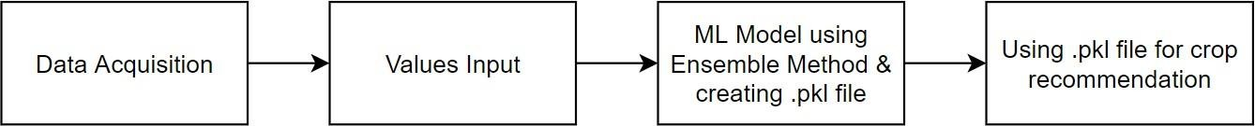
Figure 1 : Methodology for Crop Recommendation
Data Acquisition for Fertilizer Recommendation :
Manually create a dataset by collecting data from verified sources such as The Fertilizer Association of India, Kaggle
Values Input:
Users input site-specific parameters including N, P, K (expressed as percentages), and select the crop
Calculate the difference between the desired values of N, P, K for the selected crop
Fertilizer Recommendation:
Based on the calculated differences for N, P, K, recommend appropriate fertilizer types and quantities to address the deficiencies or excesses.

Slide 12
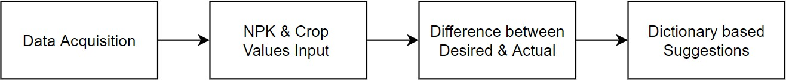
Figure 2 : Methodology for Fertilizer Recommendation
Data Acquisition for Pesticide Recommendation :
Utilize automated scripts with Selenium and Chrome Driver to scrape images from Google for various pests. Additionally, provide labels for each pest.
Data Cleaning and Data Augmentation:
Manually clean the scraped data to remove irrelevant content (e.g., images of cars instead of pests).Augment the dataset to increase variability and improve model performance.
DL Model Creation:
Configure the deep learning model architecture, training parameters, and evaluation metrics. Train the model using the cleaned and augmented dataset to identify pests accurately. Create an .h5 file to store the trained model for future use.

Slide 13
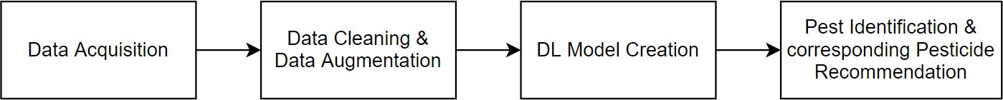
Pest Identification and Pesticide Recommendation:
Load the trained .h5 model to identify the pest from the input image. Based on the identified pest, recommend the corresponding pesticide using a dictionary-based solution.
Figure 3 : Methodology for Pesticide Recommendation

Slide 14
ADVANTAGES AND DISADVANTAGES
Advantages
Accuracy: Recommendations are tailored, enhancing farming outcomes.
Efficiency: Automation saves time and labor in decision-making.
Profitability: Optimal practices lead to increased yield and income.
Disadvantages
Data Dependency: Recommendations rely on high-quality data.
Resource Intensive: Requires initial investment in technology and expertise.
Scope Limitations: May not cover all scenarios or adapt quickly to changes.

Slide 15
APPLICATIONS
Farm Management Systems: Integrates with farm management software to streamline decision-making processes and improve overall efficiency.
Government Policies: Supports policymakers in designing and implementing agricultural policies by providing insights into farming practices and challenges.
Research and Development: Facilitates research in agronomy and agricultural science by analyzing large datasets and identifying trends and patterns.
Education and Training: Serves as a tool for educating farmers about modern agricultural practices and technologies, enhancing their skills and knowledge.

Slide 16
CONCLUSION
“Crop Optimization” is not limited to current usage, it can be extended to many features as discussed below”:
Crop optimization currently supports 22 crops that are apple, banana, blackgram, chickpea, coconut, coffee, cotton, grapes, jute, kidney beans, lentil, maize, mango, mothbeans, mungbean, muskmelon, orange, papaya, pigeon peas, pomegranate, rice, watermelon. Later on, the admin can add other crops. Moreover in the future, fertilizers can also be added accordingly. The training was done on 10 pests: aphids, armyworm, beetle, bollworm, earthworm, grasshopper, mites, mosquito, sawfly and stem borer and with this pesticides are suggested. In future, training can be done on more pests and more pesticides can also be added according to the pests.
In Crop Recommendation, values are manually entered by the user of temperature, humidity, rainfall. Admin can also use some weather API to fetch the real time parameters by the city and state.

Slide 17
In Pesticide Recommendation, the uploaded image should be clear for correct results, otherwise with a blur image, the system sometimes gives wrong results so, further filters can be used to obtain better results. Also the system can use better DL models.
In future pesticide code can be integrated with drone code so that it can take live pictures of pests and by email or by mobile the farmers would be notified about the pest along with the pesticides.

Slide 18
REFERENCE
Rajak, Rohit Kumar, et al. “Crop Recommendation System to Maximize Crop Yield using Machine Learning Technique.” International Research Journal of Engineering and Technology (IRJET), vol. 04, no. 12, 2017, pp. 951-952. IRJET
Dighe, Deepti, et al. “Crop Recommendation System for Precision Agriculture.”IRJET, vol. 05,no.11,2018,pp.476-480.IRJET.
Mokarrama, Miftahul Jannat, and Mohammad Shamsul Arefin. “RSF: A Recommendation System for Farmers.” Region 10 Humanitarian Technology Conference, vol. 2, no. 17, 2017
Gandge, Yogesh, and Sandhya. “A study on various data mining techniques for crop yield prediction.”IEEEXplore,2017.IEEEXplore
Mishra, Shruti, et al. Use of data mining in crop yield prediction. 2018. ResearchGate,

Slide 19


